Slide 1
ECE 2031 Final Project Proposal

Slide 2





Introductions
Patrick Mock
2nd Year EE Major
Mitchell Turton
2nd Year CompE Major
Anthony Kennedy
2nd Year EE Major
Chinmay Bandapalli
1st Year EE Major
Landon Slater
1st Year CompE Major
Notes:
[ All ]

Slide 3
Design Problem and Project Summary
For this project we were tasked with creating a SCOMP peripheral that:
Can interface with and control the LEDs on the DE10 board
Provides functionalities that would be useful to a SCOMP programmer
Is easy and intuitive for a SCOMP programmer to use
Notes:
[ Landon ] Speaker Notes Here:
IGNORE WHILE PRESENTING (used to help make slides):
"Summarize the design problem and the project requirements to ensure that your viewer is prepared to understand your specific proposal from your perspective of the project.”
Design problem / Project Requitements Summary (why did we make this) –

Slide 4
Our solution to the task at hand
Create a peripheral for SCOMP with the following functionalities:
Set all LEDs using a bitmask
Sets which LEDs are turned on by sending a 10-bit value to serve as a bit mask
Turn on a specific LED
Targets a specific LED with an index from 0 to 9, and sets its value without affecting the other LEDs
Set brightness of a specific LED
Sets the brightness of a specified LED with an index from 0 to 9, with a brightness represented by 8 bits with values from 0 to 255
Notes:
[ Patrick ] Speaker Notes Here:
Based on the criteria set forth by our customer we decided to create a peripheral for SCOMP with the following 3 functionalities
- the first feature is setting all the LEDs using a bit mask: this takes in a 10-bit number which serves as a mask to turn on or off the 10 LEDs
- the second feature is turning on a specific LED: this takes in an index from 0 to 9 and turns on the LED at that given index
- the third feature is setting the brightness of a specific LED:
Reasons for implementation:
Set All LEDs using bitmask / specific LED:
- There are times when a programmer wants to set the state of all LEDs at once in one operation, but there are also times when a programmer may only want to set the state of one LED without effecting the others. By having both the bitmask and individual LED functionality we allow the programmer to use whichever way is most convenient for them.
Set brightness of a specified LED:
- Having a finer grain control over the brightness of an LED as well as being able to set brightness individually for each LED is a very powerful and useful feature for a programmer to have while using the SCOMP.
IGNORE WHILE PRESENTING (used to help make slides):
what our intended design/peripheral device is and what functionality it will provide to the end user
“Briefly describe your team’s solution to the problem – enough to introduce the rest of the technical content.”
Solution (what did we make to solve the problem/ requitements and what is its core functionality) -

Slide 5
Implementation
[ x x | x x x x | x x x x x x x x x x ]
[ OP_Code (2 bits) | LED_Sel (4 bits) | Data (10 bits) ]
To be able to perform more than one functionality we split the 16-bit IO_Data input from SCOMP into several sections:
OP_Code: 2 bits that represent what function the peripheral will perform
LED_Sel: 4 bits that determine which LED we are targeting
Data: 10 bits that store the data itself we want to send to the peripheral
All 10 used for setting bitmask
Only lower 8 bits used when setting brightness
Only first bit used when setting a single LED state
OP_Code | Function
00 | Set bitmask
01 | Set Single Bit
10 | Set Brightness
11 | Open for a potential extra feature
Notes:
[Anthony] Speaker Notes Here:
- additional notes from me: when talking about how we have and are going to test also talk about what happens when the tests tell us something is wrong and how we would generally go about debugging that. Whether that be changing inputs, using signal tap, etc.
IGNORE WHILE PRESENTING (used to help make slides):
Br_Reg[0] = 128 where we have a 50% duty cycle, ST_Reg = 0000000001 (bit-mask for LED 0)
We haven't fully tested decoding the io data but we have tested:
Bit mask works
Pwm works
How to we plan to test that our peripheral is working like we want to and debug when problems arise
We plan to use functional simulation waveform as it is easy to manipulate values such as IO_Data
Talk to Chinmay/Mitchell to see how they debugged
Waveform simulation files
Manually setting CS rising edges along IO_Data utilizing different opcodes (bit-mask, brightness)
Example of setting brightness to half for LED 0 on the DE-10:

Slide 6
Implementation
Registers | Bit-Width | Description | Default State
ST_REG | 10-bit | Show active LEDs | 00000000000
BR_REG[0 – 9] | 8-bit | Display Brightness Level | 11111111
There are 11 Registers we use internally:
One 10 bit "State Register" which determines if an LED is "on" (1) or "off" (0) with each bit corresponding to 1 LED
There are 10 Brightness Registers that are 8 bits each that hold the brightness value of each LED
This value is fed into a PWM generator to create a square wave of the correct duty cycle to create the correct "brightness"
Notes:
[Anthony] Speaker Notes Here:
- additional notes from me: when talking about how we have and are going to test also talk about what happens when the tests tell us something is wrong and how we would generally go about debugging that. Whether that be changing inputs, using signal tap, etc.
IGNORE WHILE PRESENTING (used to help make slides):
Br_Reg[0] = 128 where we have a 50% duty cycle, ST_Reg = 0000000001 (bit-mask for LED 0)
We haven't fully tested decoding the io data but we have tested:
Bit mask works
Pwm works
How to we plan to test that our peripheral is working like we want to and debug when problems arise
We plan to use functional simulation waveform as it is easy to manipulate values such as IO_Data
Talk to Chinmay/Mitchell to see how they debugged
Waveform simulation files
Manually setting CS rising edges along IO_Data utilizing different opcodes (bit-mask, brightness)
Example of setting brightness to half for LED 0 on the DE-10:

Slide 7
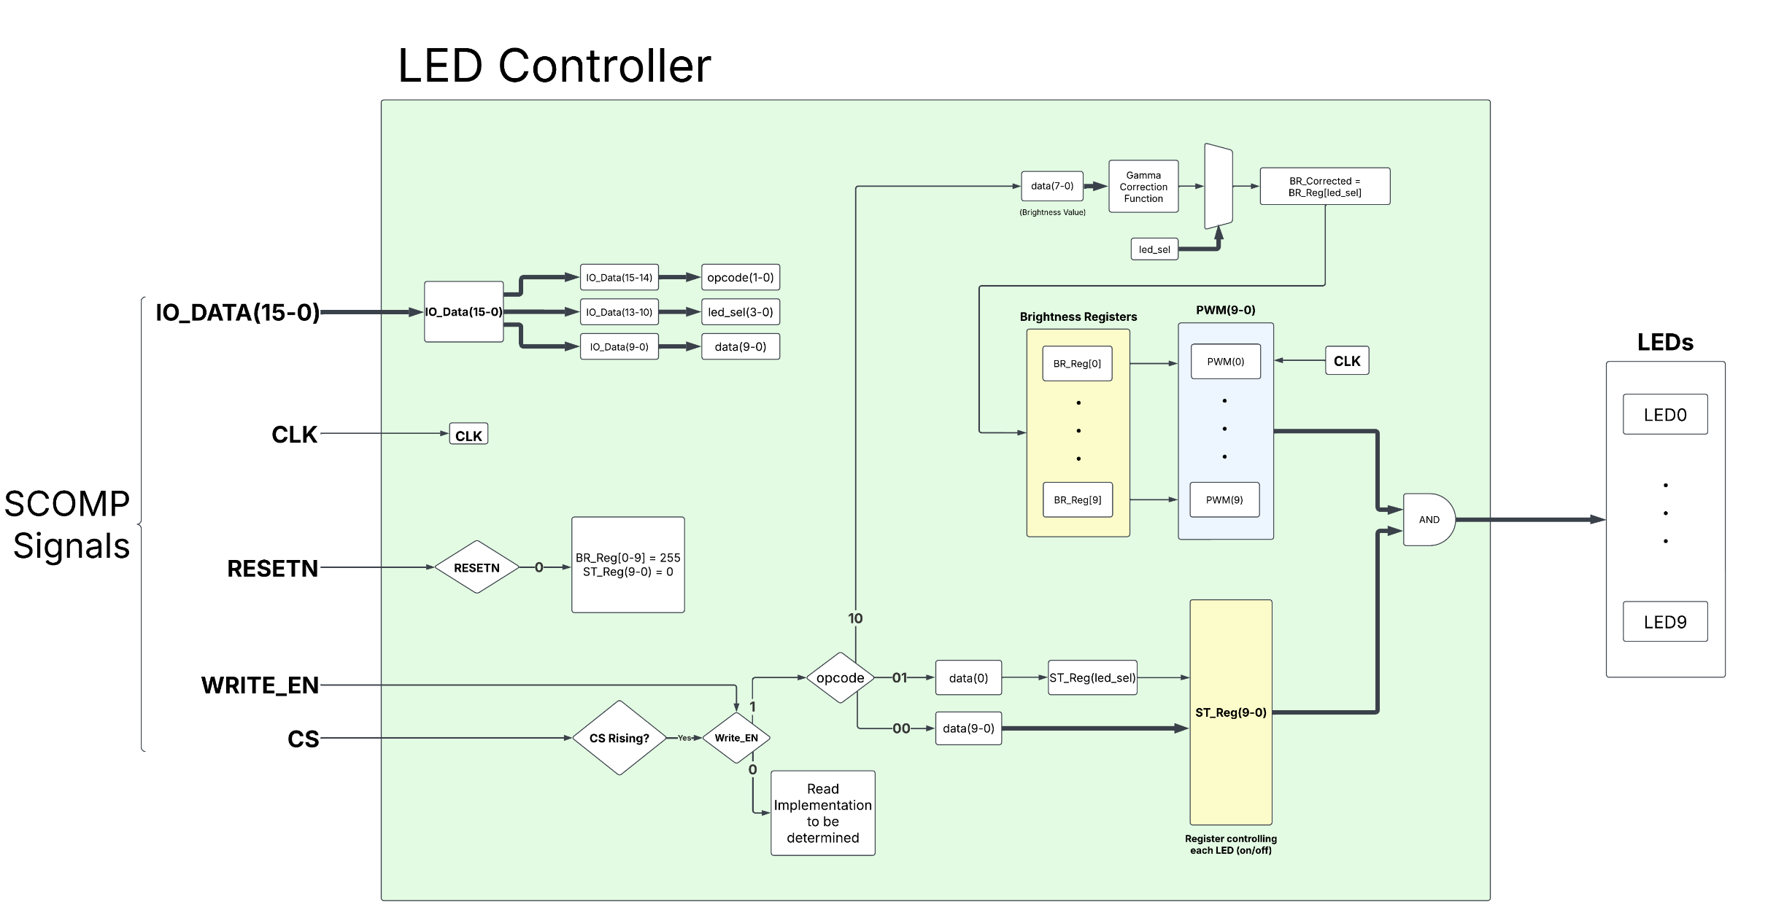
Implementation
Notes:
[ Chinmay ] Speaker Notes Here:
Inputs:
- IO_Data: data coming in from the SCOMP
- How it is splitup [don’t go into detail already covered]
- CLK: Used by the PWM generators
- RESETN: when brought low sets Registers to default state 255 for BR_Reg and 0 for ST_Reg
- Write_En: whether SCOMP wants to READ or WRITE to the peripheral
- If we are wrting we split funcitionality based on what op_code was sent
- CS: Chip Select tells us when to update registers
ST_Reg is anded together with PWM to be able to turn LED on/off without losing what the brightness value stored is.
Inputs: Diagram (In Progress - 60% complete)
Breakdown of how IO_Data is split up
Usage of 11 Registers: 1 to monitor the state; final 10 to display individual brightness of LEDS
Maybe parts of API
[Chinmay / Mitchell / Anthony ]
IGNORE WHILE PRESENTING (used to help make slides):
“Describe the technical approach you are proposing, addressing the requirements from the project description.”
“…how your team will solve the problem (how you will design, implement, and test)”

Slide 8
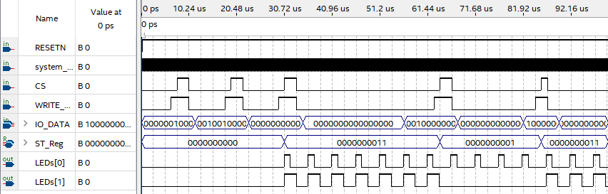
Testing and Debugging - Simulation
We test our peripheral both in simulation and on the physical device
In our functional simulation we isolate just the peripheral and simulate the inputs SCOMP would send to validate:
Registers have correct behavior as we test a variety of different inputs
PWM signal gives correct duty cycle
State Register passes / blocks signals as intended
Reset works as intended
Notes:
[Mitchell] Speaker Notes Here:
- additional notes from me: when talking about how we have and are going to test also talk about what happens when the tests tell us something is wrong and how we would generally go about debugging that. Whether that be changing inputs, using signal tap, etc.
IGNORE WHILE PRESENTING (used to help make slides):
Br_Reg[0] = 128 where we have a 50% duty cycle, ST_Reg = 0000000001 (bit-mask for LED 0)
We haven't fully tested decoding the io data but we have tested:
Bit mask works
Pwm works
How to we plan to test that our peripheral is working like we want to and debug when problems arise
We plan to use functional simulation waveform as it is easy to manipulate values such as IO_Data
Talk to Chinmay/Mitchell to see how they debugged
Waveform simulation files
Manually setting CS rising edges along IO_Data utilizing different opcodes (bit-mask, brightness)
Example of setting brightness to half for LED 0 on the DE-10:

Slide 9
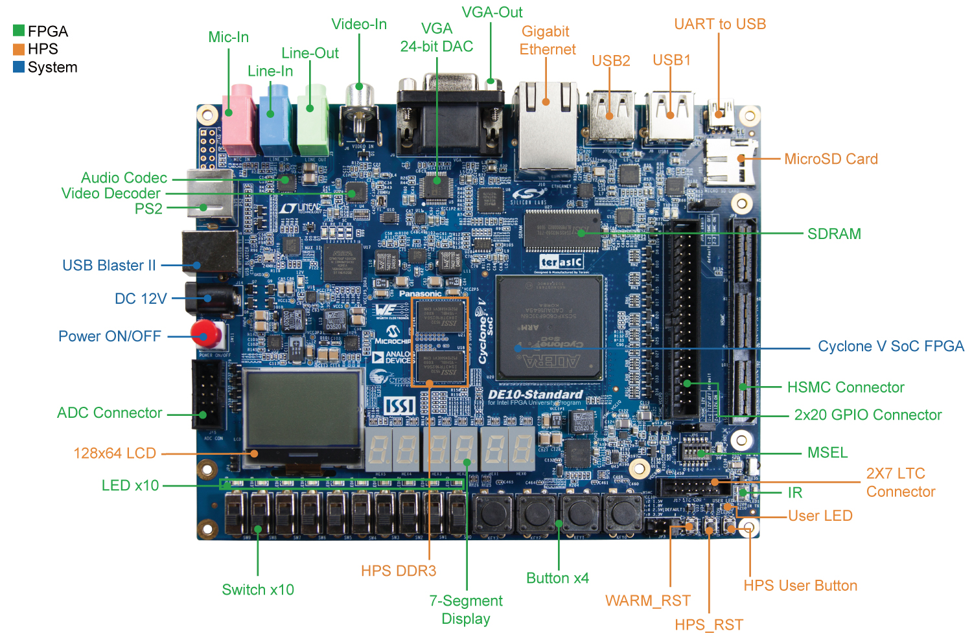
Physical Testing and Debugging
To physically test our peripheral, we:
Write a simple SCASM test program
Upload VHDL to the DE-10
Fix issues not seen in Functional Simulation:
PWM clock being at correct rate to correctly see differences in LED brightness
Interface with SCOMP working as intended
Will use digital logic probes and oscilloscope to debug if issues arise
Notes:
[ Mitchell ] Speaker Notes Here:
- additional notes from me: when talking about how we have and are going to test also talk about what happens when the tests tell us something is wrong and how we would generally go about debugging that. Whether that be changing inputs(simulation), using signal tap(physical), etc.
IGNORE WHILE PRESENTING (used to help make slides):
Br_Reg[0] = 128 where we have a 50% duty cycle, ST_Reg = 0000000001 (bit-mask for LED 0)
We haven't fully tested decoding the io data but we have tested:
Bit mask works
Pwm works
How to we plan to test that our peripheral is working like we want to and debug when problems arise
We plan to use functional simulation waveform as it is easy to manipulate values such as IO_Data
Talk to Chinmay/Mitchell to see how they debugged
Waveform simulation files
Manually setting CS rising edges along IO_Data utilizing different opcodes (bit-mask, brightness)
Example of setting brightness to half for LED 0 on the DE-10:

Slide 10
Project status update
Completed the VHDL for a basic LED control peripheral that has 3 functionalities:
Setting all LEDs using a bitmask - Tested: Works ✔️
Setting the brightness of a specific LED - Tested: Works ✔️
PWM – Tested: Works ✔️
Turning on a specific LED without affecting others - Tested: Works ✔️
At this point we have tested using functional simulation and know our device:
Correctly decodes a simulated SCOMP inputs
Outputs the correct duty cycle to the LEDs
Testing on physical DE-10 Board required to confirm:
LED brightness changes as we expect
Interface with SCOMP works properly
Need to implement:
Gamma Correction
Read Functionality
Notes:
Next up, we have a status update for our project:
So far, we have:
Completed the VHDL for a basic LED control peripheral which has the 3 functionalities discussed earlier:
Setting all LEDs using a bitmask - Tested: Works ✔️
Setting the brightness of a specific LED - Tested: Works ✔️
PWM – Tested: Works ✔️
Turning on a specific LED without affecting others - Tested: Works ✔️
At this point we have tested using functional simulation but not yet with the actual DE 10 borad itself. This tells us that:
the peripheral can correctly decode simulated SCOMP inputs
and it can correctly output the duty cycle for the LEDs
However since we haven’t done a physical test yet we still need to confirm:
At this point we have tested using functional simulation and know our device:
LED brightness changes as we expect
Interface with SCOMP works properly
(still don’t know how brightness translates to actual DE10 boards LEDs. Don’t know how much time the LEDs are on or off, only the percentage)
IGNORE WHILE PRESENTING (used to help make slides):
“If you have already done some experiments (which at the time of the proposal you should have), include relevant results to support the feasibility of your design. Anything that you can prove is already working will increase confidence in your proposed plan.”
Talk about what we have done so far and how are expectations/ plan have changed b/c of this
Experiments done : testing the ST_Reg and Br_Reg (both work) testing PWM generation
Haven’t tested set bit yet but every other functionality is working

Slide 11
Demo Plan
Current Demonstration Plan:
Loading Bar Looping Animation (SCOMP)
Shows LED select (setting all LEDs at once to reset)
Shows Specific LED toggles
Shows brightness selection
Notes:
[ Landon ] Speaker Notes Here:
- additional notes from me: none rn

Slide 12
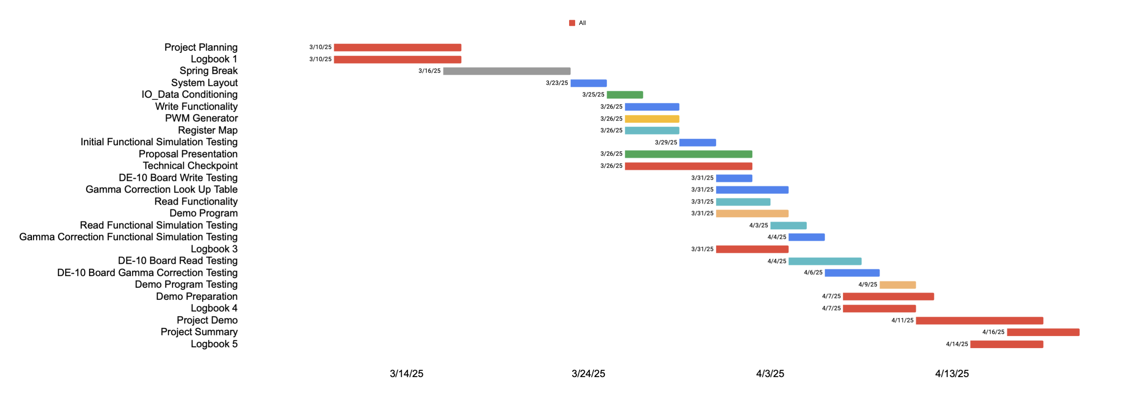
Management Plan / timeline
Notes:
[ Mitchell ]

Slide 13
Final Remarks
For this project, we were tasked with creating an intuitive and useful LED interface peripheral for SCOMP.
We have proposed and are currently working on a prototype that satisfies most of the needs of our customer.
As we stand, we have a peripheral that has working core functionality and still working to implement even more features (read, gamma correction, etc.)
Although we haven’t fulfilled all the deliverables for the project yet, we are confident that we are still on schedule to deliver a fully functional peripheral that fulfills all the requirements given.
Notes:
[ Chinmay ]

